Slide 1

PROJECT AGNISHAKTI: AI-Powered Fire Safety System
Presented by: Anurag Anand, Hersita Chandak, Shudhanshu Kumar, Raunak Raj

Slide 2
Primary Objective: Real-Time, Low-Cost Safety
Core Technology
Hardware Flexibility
Build a real-time, low-cost fire & smoke detection system using YOLOv8.
Works on existing CCTV/webcams; no extra sensors or sprinklers required.
Automated Response
Incident Visualization
Auto-alerts the nearest fire station and owners instantly.
Visualizes incidents and live status on a society map dashboard.

Slide 3

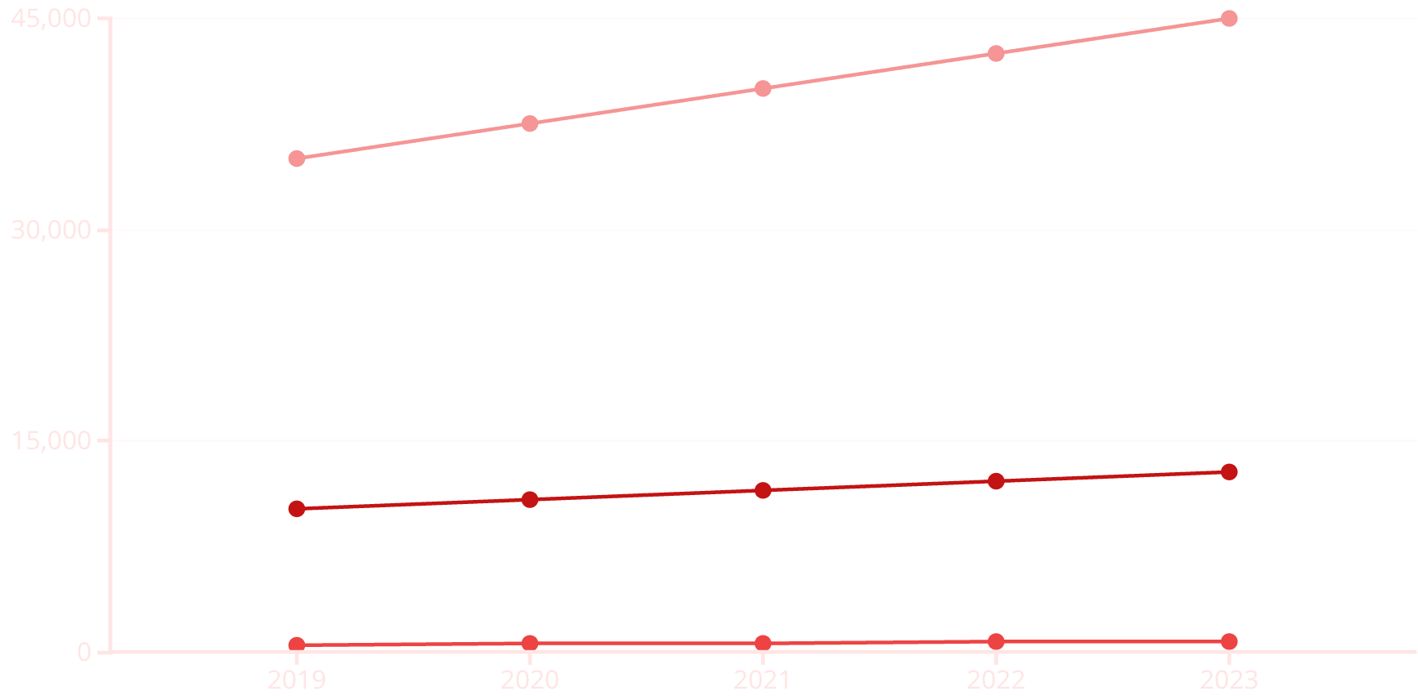



Functional Objectives: Comprehensive Coverage
Fire Incident Trends in India (Recent Years)
Dual AI Detection
Detect fire and smoke in live video feeds using custom-trained YOLOv8 models.
Multi-Camera Support
Per-house camera mapping for precise location identification.
Automated Alerting
Fatalities
Property Losses (INR Crores)
Incidents
Fetch house ID, email fire station/owner with timestamp, snapshot, and confidence score.
The chart illustrates a concerning upward trend in fire-related incidents in India over the past few years. Annual fatalities, property losses (in INR Crores), and the overall frequency of incidents have all shown a steady increase, highlighting the urgent need for enhanced fire safety measures and advanced detection systems to mitigate these growing risks.
Society Map Dashboard
Live status visualization and role-based login (Owner / Admin / Fire-Station).

Slide 4

The Problem: A Global Fire Crisis
180K+
20
5
Global Fatalities
India's Crisis
Alert Latency Target
People die due to fire-related incidents
globally every year.
One person dies in a fire every 20 minutes
in India (NCRB Report).
End-to-end alert latency target is ≤ 5
seconds.
Delayed detection and poor alerting systems cause thousands
of preventable deaths each year.
Traditional Systems are Inadequate
Expensive (₹1,50,000+ per society).
Hardware-dependent and complex installation.
High maintenance costs (₹50,000/year).
High false alarm rates create distrust.

Slide 5




AgniShakti: AI That Sees Fire Before It Spreads
Dual AI Detection
Automated Alert System
Live Dashboard
YOLOv8 models trained for real-time accuracy (mAP ≥ 0.85).
Society map with color-coded status (Green/Yellow/Red) and role-based access.
Instant email to fire station & owners with location and snapshot (<5 sec delivery).

Slide 6





AgniShakti's Multi-Layered Intelligence
Monitoring Layer
Unified dashboard for managing multiple properties and cameras.
Action Layer
Fire stations and owners receive live updates with image evidence.
Manual Override Layer
Owners can pause detection with a password-protected button.
False Alarm Control Layer
Gemini API validation ensures only real incidents trigger alerts.
AI Detection Layer
YOLOv8s model trained for fire and smoke separately.

Slide 7
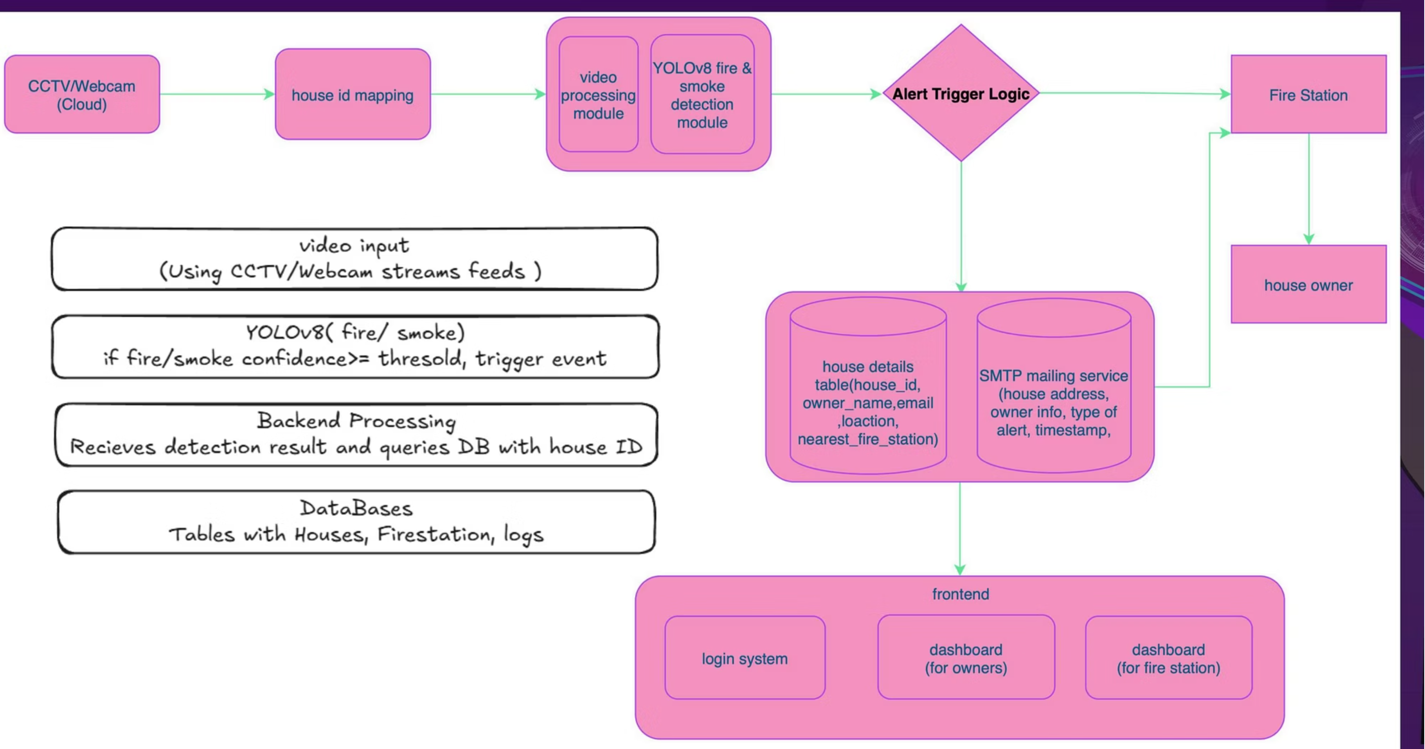

Slide 8
System Architecture and Core Models
Input Layer
CCTV / Webcams streaming live feed.
Detection Layer
YOLOv8 models (Fire + Smoke) for real-time inference.
Backend Processing
Matches camera ID to owner details, prepares alert message.
Database Layer
Stores map, house IDs, owner info, and fire station mapping (Firebase).
Alerting System
Email sent to fire station and owner with incident details and snapshot.
Dashboard
Displays society map with live, color-coded status updates.
YOLOv8s (Target)
0.90
30
22MB
YOLOv5
0.85
25
28MB
Faster R-CNN
0.88
12
108MB

Slide 9







Technology Stack and Tools
Programming & Frameworks
Database & Storage
Python, YOLOv8 (Ultralytics), OpenCV, Flask/FastAPI for backend APIs.
Firebase for storing house IDs, owner details, fire station mapping, and alert logs.
Frontend & Visualization
Alert & Communication
ReactJS / HTML-CSS-JS for the dashboard and society map interface.
SMTP for automatic email alerts. Future scope: Twilio for SMS/WhatsApp.

Slide 10
Competitive Advantage and Cost Analysis
Why AgniShakti Wins
5-Year Total Cost Comparison
Initial Cost
Very High (₹2.8L+)
Low (₹20K)
60K
AgniShakti
Alert Speed
30-60 sec
<5 sec
Low initial investment and minimal annual operating costs.
Visual Verification
No
Yes (Snapshot)
600K
False Positives
High
Low (AI-filtered)
Traditional System
High initial setup, maintenance, and sensor replacement costs.

Slide 11



Phase 1: Foundation & Beachhead Market (Months 0-12)
Our initial strategy focuses on securing a strong foothold in residential apartments and gated communities within Indian cities. This segment offers a strategic entry point for rapid growth and market validation.
Why This Beachhead Market?
Ideal Audience
Concentrated Demand
Existing Infrastructure
Residential apartments and gated communities prioritize safety, have high-value assets, and a collective willingness to invest in advanced security solutions.
Multiple units within a single complex allow for efficient sales, bulk installations, and streamlined service management, reducing acquisition costs.
Many of these communities already possess basic security setups, making integration or upgrading to AgniShakti a logical and easier transition.
Solving Critical Pain Points
False Alarms & Slow Response
Lack of Visual Verification
High Costs & Maintenance
Traditional systems suffer from frequent false alarms and delayed response times, undermining trust and effectiveness.
Without immediate visual proof, security teams struggle to assess threats accurately, leading to inefficient resource deployment.
Existing solutions often come with prohibitive initial costs, complex maintenance, and frequent sensor replacements.
Proven ROI with AgniShakti
AgniShakti delivers significant returns by drastically reducing false positives (AI-filtered), ensuring ultra-fast alerts (<5 seconds), providing critical visual verification, and offering a dramatically lower 5-year total cost of ownership compared to traditional systems.
Scaling Plan: Months 0-12
01
02
Pilot Deployments
Channel Partnerships
Initial deployments in select communities to gather feedback, showcase efficacy, and build strong case studies.
Collaborate with security integrators, property management firms, and residential associations for broader market reach.
03
04
Direct Sales Team
Referral Programs
Establish a dedicated sales force focused on engaging with key decision-makers within large residential complexes.
Incentivize existing clients and community members to advocate for AgniShakti, leveraging word-of-mouth for organic growth.

Slide 12




Phase 2: Vertical Expansion & Product Diversification (Months 12-24)
Building on our initial success, Phase 2 targets Small and Medium Businesses (SMBs) and high-risk verticals, leveraging AgniShakti's core strengths for broader market penetration.
Why Expand to These Verticals?
Higher Willingness to Pay
Regulatory Compliance
New Use Cases & Integrations
These sectors often have dedicated budgets for advanced security solutions due to high-value assets, critical infrastructure, or sensitive data.
Industries like healthcare, education, and finance face strict compliance mandates, making robust security a non-negotiable requirement.
Diversification unlocks new applications beyond residential, such as access control, asset tracking, and specialized environmental monitoring.
Targeting High-Risk Verticals
Hospitality
Warehouses & Logistics
Ensuring guest safety, property protection, and monitoring public areas in hotels, resorts, and convention centers.
Preventing theft, securing inventory, and monitoring large perimeters in storage facilities and distribution hubs.
Educational Institutions
Retail Malls
Enhancing campus safety for students and staff, securing valuable equipment, and managing access to facilities.
Deterring shoplifting, managing crowd flow, and providing rapid response capabilities in commercial complexes.
Enhancing AgniShakti: Product Development
Advanced Alert Systems
AgniShakti Pro Features
Integration of real-time SMS and WhatsApp alerts for immediate incident notifications, improving response times.
Developing specialized features such as advanced analytics, customizable reporting, and third-party system integrations tailored for enterprise clients.

Slide 13



Phase 3: Geographic & Platform Scaling (Months 24-36)
In Phase 3, we shift our focus to global markets and critical public infrastructure, aiming for exponential growth by leveraging our proven technology and expanding our "Safety-as-a-Service" platform.
Why Target Global & Public Sectors?
Massive Total Addressable Market (TAM)
First-Mover Advantage
Significant Public Sector Impact
Global security spending on smart solutions for public and commercial spaces represents a multi-billion dollar opportunity.
Entering emerging markets and specialized public sectors early allows us to establish dominance and build strong relationships.
Contributing to national safety and security initiatives, fostering trust, and establishing AgniShakti as a critical national asset.
Public Sector Engagement & Tenders
We will actively pursue government tenders for critical infrastructure and public buildings, tailoring our solutions to meet specific national security and safety mandates.
Government Buildings
Public Transportation Hubs
Securing administrative offices, parliamentary buildings, and other high-security government facilities with integrated threat detection.
Implementing safety solutions in airports, railway stations, and bus terminals to enhance passenger security and operational resilience.
Platform Innovation: Safety-as-a-Service (SaaS)
Evolving AgniShakti into a comprehensive SaaS platform offering multi-hazard detection and proactive risk management for enterprise and public sector clients.
Cloud-Native Architecture
Multi-Hazard Detection
Predictive Analytics & Reporting
Scalable, secure, and easily deployable platform for seamless integration and remote management across diverse environments.
Expanding detection capabilities beyond fire to include gas leaks, chemical spills, structural integrity issues, and other environmental threats.
Leveraging AI to provide real-time insights, predict potential incidents, and generate comprehensive compliance reports for stakeholders.

Slide 14






Phase 4: The Ecosystem & Enterprise Play (Month 36+)
In Phase 4, AgniShakti transitions into a mature ecosystem player, forging deep relationships with enterprise clients and insurance giants. This phase leverages our established technology to deliver unparalleled value through strategic integrations and predictive capabilities, expanding our reach and impact exponentially.
Why This Strategic Focus?
Largest Contract Values
Strategic Partnerships
Data-Driven Insights
Enterprise an revenued insurance sectors offer high-value, long-term contracts, ensuring sustainable growth and market leadership.
Collaborations unlock new distribution channels, enhance our solution's versatility, and solidify AgniShakti's position in critical infrastructure protection.
Access to vast datasets from these sectors refines our AI, enabling more accurate predictions and proactive safety measures.
Unlocking Integration with an API-First Approach
Our robust API-first strategy allows for seamless integration with existing systems, creating a powerful, interconnected safety ecosystem.
Security System Integrators
IoT Device Manufacturers
Developer Ecosystem
Enabling comprehensive solutions by integrating AgniShakti's detection capabilities into broader security frameworks.
Expanding our data collection and response network by connecting with a myriad of smart sensors and devices.
Fostering innovation by empowering third-party developers to build custom applications and services atop our platform.
Synergistic Insurance Alliances
Partnering with insurance companies to offer mutual benefits, from risk reduction to innovative policy structures.
Premium Discounts
Enhanced Risk Assessment
Claims Reduction
Clients implementing AgniShakti solutions qualify for reduced insurance premiums due to demonstrably lower risk profiles.
AgniShakti's real-time data and predictive analytics provide insurers with unprecedented insights into asset vulnerability.
Proactive incident prevention and rapid response capabilities significantly reduce the frequency and severity of insured events.
Driving Smarter Decisions with Predictive Analytics
Beyond immediate threat detection, AgniShakti's AI-driven predictive analytics become an invaluable tool for long-term planning and resilience.
City Planners
Disaster Management
Infrastructure Owners
Informing urban development strategies, infrastructure placement, and public safety initiatives with data-driven risk insights.
Providing critical foresight into potential hazards, enabling pre-emptive resource allocation and accelerated emergency response.
Optimizing maintenance schedules and capital investments by predicting points of failure or vulnerability within critical assets.

Slide 15
AgniShakti's Phased Growth Strategy
Phase 1: Foundation & Beachhead Market (Months 0-12)
Target: Residential apartments in cities
Revenue Projection: ₹50L-1Cr from 100-200 residential societies.
Phase 2: Vertical Expansion (Months 12-24)
Key Activities: Pilot deployments, establishing initial channel partnerships. Focus on proving core technology and market fit.
Target: SMBs and high-risk verticals (hospitality, warehouses, education, retail)
Revenue Projection: ₹5-10Cr from SMB and vertical expansion.
Key Activities: Launching AgniShakti Pro with advanced features tailored to specific industry needs, expanding sales channels.
Phase 3: Geographic & Platform Scaling (Months 24-36)
Target: Global markets, public infrastructure
Revenue Projection: ₹25-50Cr from global markets and public sector contracts.
Phase 4: Ecosystem & Enterprise Play (Month 36+)
Key Activities: Deploying Safety-as-a-Service (SaaS) platform, international expansion, securing contracts for large-scale public infrastructure projects.
Target: Enterprise clients, insurance companies
Revenue Projection: ₹100Cr+ from enterprise clients and insurance partnerships.
Key Activities: Implementing an API-first strategy for seamless integration, developing advanced predictive analytics, forming deep strategic alliances with enterprise and insurance giants.

Slide 16










Impact and Future Scope
Property Protection
Lives Saved
Early detection prevents 60% of property damage, reducing average loss significantly.
Reduces fire casualties by 40-50% and response time by 58%.
Accessibility
Makes advanced safety accessible to middle-income housing with no hardware barriers.
Scalability
Global potential—wherever there's a camera, there's potential protection.
Future Scope
Mobile app, SMS/WhatsApp alerts, gas leak detection, and multi-hazard monitoring.
THANK YOU!

